Slide 1



LIBRARY BOOKS
Presentation by Group-1 CSE
PPS | 1-1
KMCE

Slide 2
PROJECT - 3
TEAM MEMBERS
23P81A0528 K RUSHI
CSE
23P81A0502 N AKHILA
CSE
23P81A0523 J BABITHA
CSE
23P81A0552 S ISHANTH REDDY
CSE
23P81A0552 K HEMASHASHEENDRA
CSE
GUIDE: MR. UMESH GOGTE

Slide 3


SOFTWARE USED
C COMPILER
DEV C++

Slide 4
DOCUMENTATION
PROBLEM STATEMENT:
Save details of at least 10 books in a library in a binary file
REQUIREMENTS:
Category Wise list.
Category Wise total and average book cost
For a given book number, give its details.

Slide 5


PROCEDURAL PROGRAMMING
void saveBookDetails();
void displayCategoryWiseList();
void displayCategoryWiseTotalAndAverage();
void displayBookDetails();
void saveBookDetailsToFile();
int loadBookDetailsFromFile();
void deleteBook();
void clearAllBooks()
int main().

Slide 6
ALGORITHM
Step-1:Start.
Step-2:Include necessary header files: stdlib.h, string.h, and stdio.h.
Step-3:Define constants and macros: MAX_BOOKS for the maximum number of books and FILENAME for the binary file name.
Step-4:Declare an enumeration enum Category to represent book
categories: Fictional, Physics, and History.
Step-5:Define a structure struct Book to store book details: book number, title, author, number of pages, category, and cost.

Slide 7
ALGORITHM
Step-6:Declare the following function prototypes :
void saveBookDetails(struct Book *books, int count);
void displayCategoryWiseList(struct Book *books, int count);
void displayCategoryWiseTotalAndAverage(struct Book *books, int count);
void displayBookDetails(struct Book *books, int count, int bookNumber);
void saveBookDetailsToFile(struct Book *books, int count);
int loadBookDetailsFromFile(struct Book *books);
void deleteBook(struct Book *books, int *count, int bookNumber);
void clearAllBooks(struct Book *books, int *count);

Slide 8
ALGORITHM
Step-7:Dynamically allocate memory for an array of struct Book to store book details (books).
Step-8:Declare bookCount , choice and initialize to bookCount=0.
Step-9:Display a welcome message and the main menu.
Step-10:Assign bookCount = loadBookDetailsFromFile(books), call the function and pass parameters, to check number of books
Step-11:Input choice.
Step-12:If user choice =1,Goto step (a).Else goto step 13.
(a):Call the function --- saveBookDetails(struct Book *books, int count)
and pass the parameters books, bookCount.
(b):If count<MAX_BOOKS, Goto step (c), else goto step (l).
(c):Input book number.Goto step (d).
(d):Validate input for book details.Goto step (e).
(e):declare and initiate i to zero.

Slide 9
ALGORITHM
(f):Set a for loop: If i<count, goto step (g). Else goto step (j).
(g):If books[i].bookNumber == bookNumber.Goto step (h).Else goto step (i).
(h):Display book already exists. Goto step (c).
(i):Increment i. Goto step (f).
(j):Set books[count].bookNumber = bookNumber.
(k):Input book title, author, pages, category ,cost. Goto step (m).
(l):Display maximum limit reached and break out.
(m):Call the function --- saveBookDetailsToFile and pass the parameters: books, bookCount.
(n):Declare a FILE pointer file and open the file in "rb+" mode.
(o):If file != NULL,goto step (p),else goto step (r).
(p):Write data to file using fwrite. [fwrite(books, sizeof(struct Book), count, file)]
(q):Close the file.
(r):Display error opening file.
(s):Increment bookCount.Goto step 9.

Slide 10
ALGORITHM
Step-13:If user choice =2,Goto step (a).Else goto step 14.
(a):Call the function --- displayCategoryWiseList and pass the parameter: books, bookCount.
(b):Display heading to display Fictional category.
(c):Declare and set i=0.
(d):If i<count, goto step (e), else goto step (h).
(e):If books[i].category == 1, goto step (f), else goto step (g).
(f):Print details of book[i].
(g):Increment i.
(h):Repeat the process for physics and history.
(i):Goto step 11.

Slide 11
ALGORITHM
Step-14:If user choice =3,Goto step (a).Else goto step 15.
(a):Call the function --- displayCategoryWiseTotalAndAverage and pass the parameters : books, bookCount)
(b):Declare categoryChoice.
(c):Input categoryChoice.
(d):Check the validity of input number i.e is number b/w 1-3.
(e):Declare totalCost, averageCost,bookCount, i and set to 0.
(f):If i<count, goto step (g), else goto step (j).
(g):If books[i].category == categoryChoice, goto step (h), else goto (i).
(h):totalCost += books[i].bookCost and increment bookCount. Goto step (i).
(i):Increment i.
(j):If bookCount >0, goto step (k), else goto step (m).
(k):Calculate averageCost = totalCost/bookCount.
(l):Print totalCost and averageCost.
(m):Display no books found in selected category.
(n):Goto step 9.

Slide 12
ALGORITHM
Step-15:If choice=4,Goto step (a), else goto step 16.
(a):Declare bookNumber.
(b):Input bookNumber
(c):Check the validity of input.
(d):Call the function --- displayBookDetails and pass the parameters: books, bookCount, bookNumber
(e):Declare i and index, set index=-1,i=0.
(f):If i<count, goto step (g), else goto step (k).
(g):If books[i].bookNumber == bookNumber, goto step (h), else goto step (i).
(h):index=i.Goto step (k).
(i):Increment i.
(k):If index!=-1, goto step (l), else goto step (m).
(l):Display book[i] details.
(m):Display Book with the specified number not found.
(n):Goto step 9.

Slide 13
ALGORITHM
Step-16:If choice=5,Goto step (a), else goto step 17.
(a):Declare bookNumber.
(b):Input bookNumber.
(c):Call the function deleteBook and pass the parameters: books, &bookCount, bookNumber.
(d):Declare i,index.Set i=0, index=-1.
(e):If i<*count,goto step (f), else goto step (i).
(f):If books[i].bookNumber == bookNumber, goto step (g), else goto step (h).
(g):index=i. Goto step (i).
(h):Increment i.Goto step (e).
(i):If index!=-1, goto step (j), else goto step (o).
(j):If i<*count, goto step (k), else goto step (m).
(k):books[i] = books[i + 1].
(l):Increment i.Goto step (j).
(m):*count--.
(n):Display book has been deleted.Goto step (p).
(o):Display Book number not found.Goto step (p).
(p):Call the saveBookDetailsToFile function and pass the parameters: books, bookCount.
(q):Goto step 9.

Slide 14
ALGORITHM
Step-17: If choice=6, goto step (a), else goto step 18.
(a):Call the function clearAllBooks and pass the parameters :books, &bookCount.
(b):Set *count=0.
(c):Display all books cleared.
(d):Call the function -- saveBookDetailsToFile and pass the parameters :books, bookCount.
(e):Perform the function as told from step 12(m) to 12(r).
(f):Goto step 9.

Slide 15
ALGORITHM
Step-18: If choice=7, Display Exiting the program, goto step 20;else goto step 19.
Step-19: Display Enter proper Input.Goto step 20.
Step-20:Stop.

Slide 16
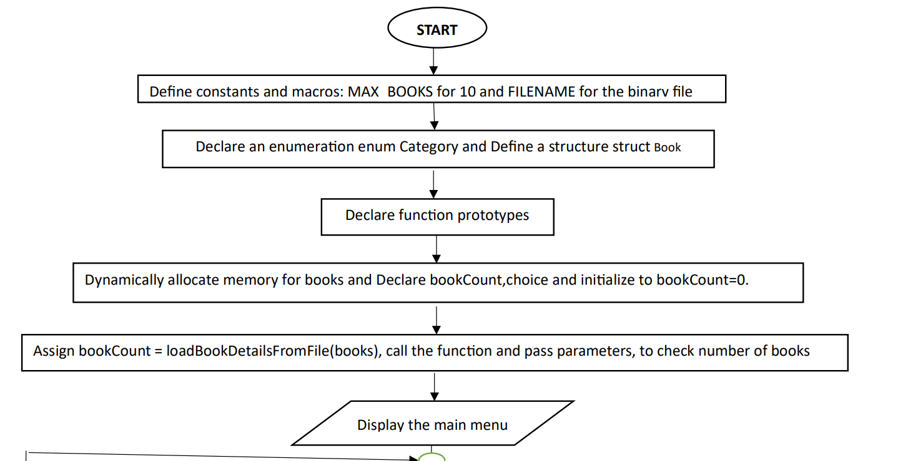
FLOWCHART

Slide 17
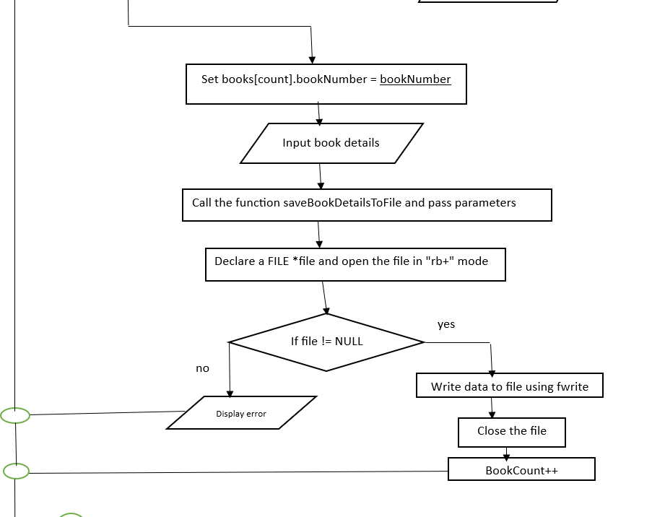
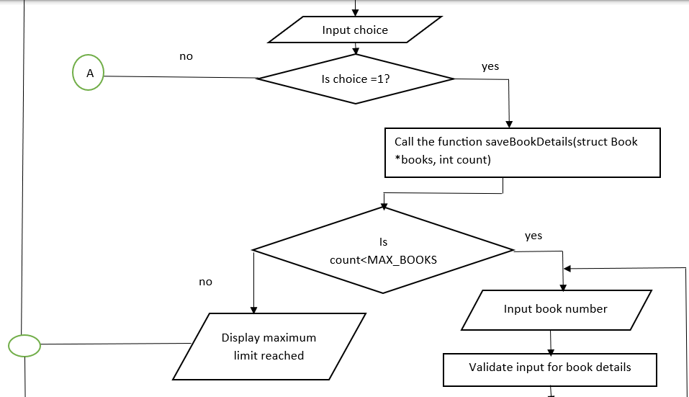
FLOWCHART

Slide 18
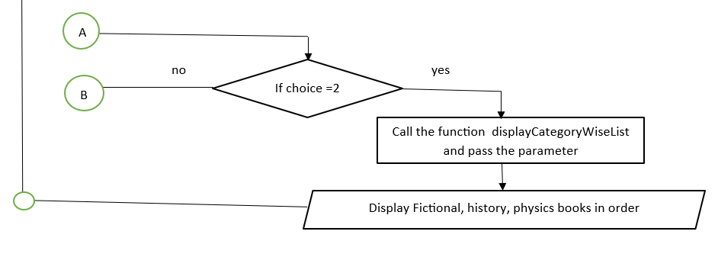
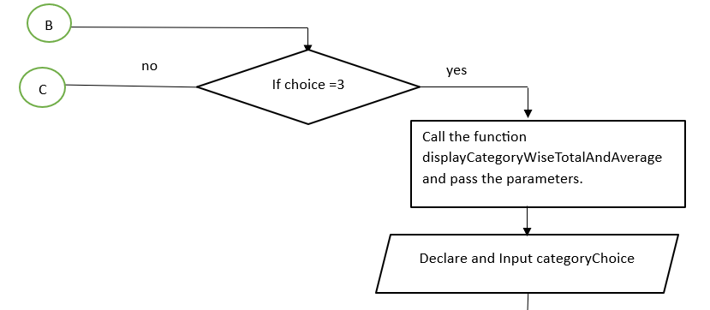
FLOWCHART

Slide 19
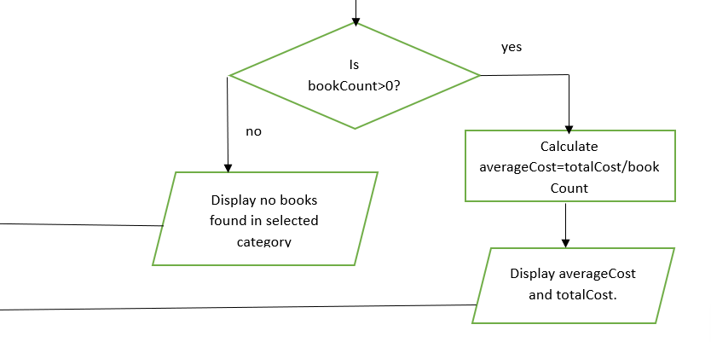
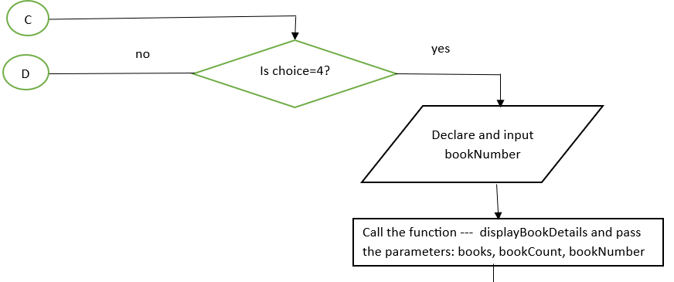
FLOWCHART

Slide 20
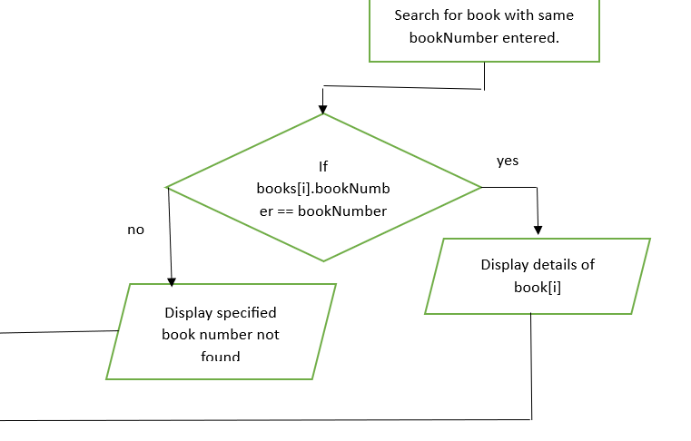
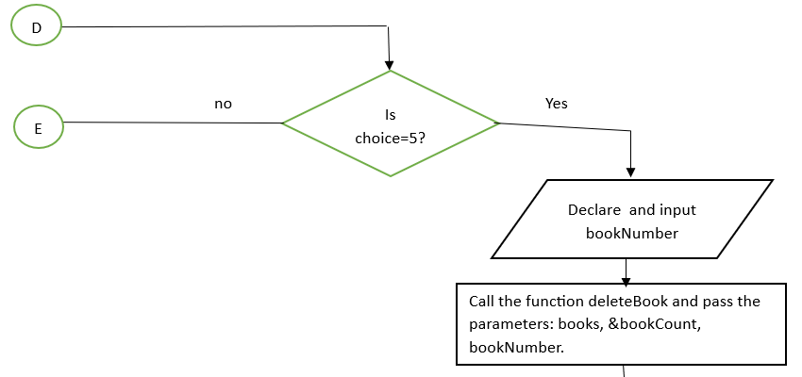
FLOWCHART

Slide 21
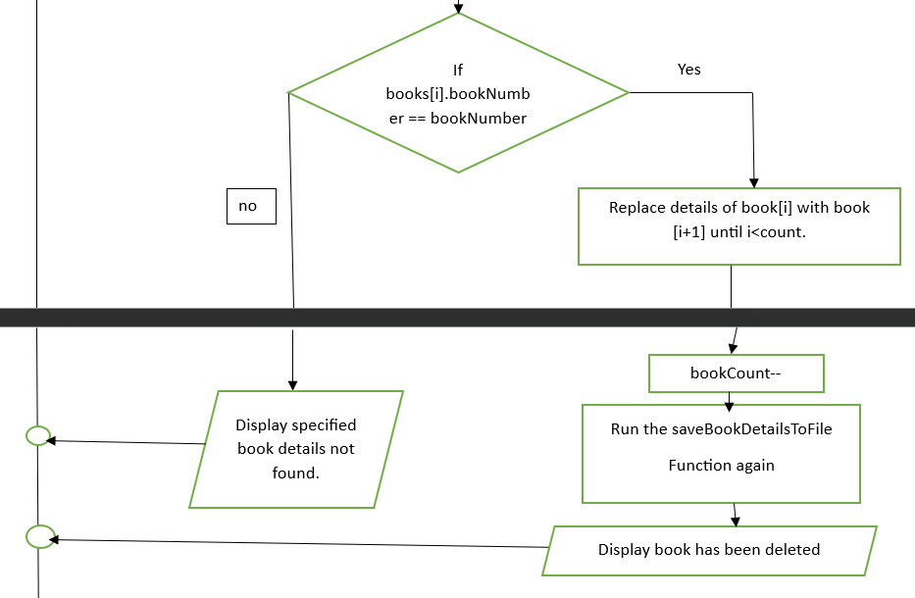
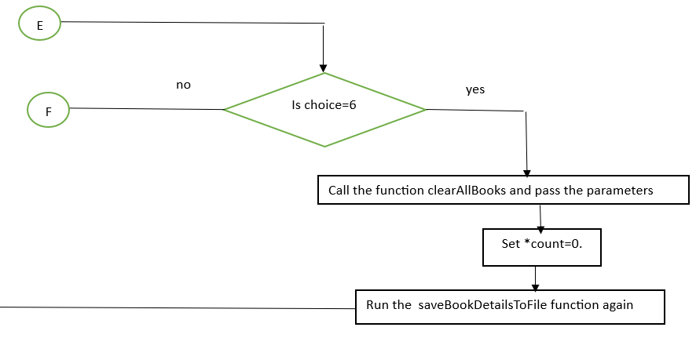
FLOWCHART

Slide 22
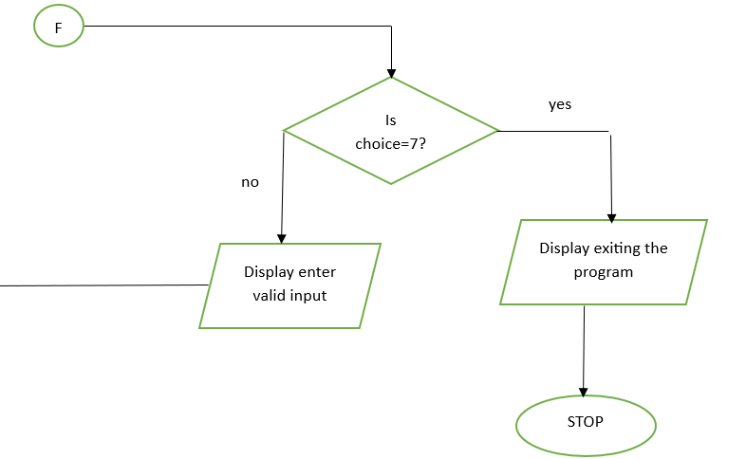
FLOWCHART

Slide 23
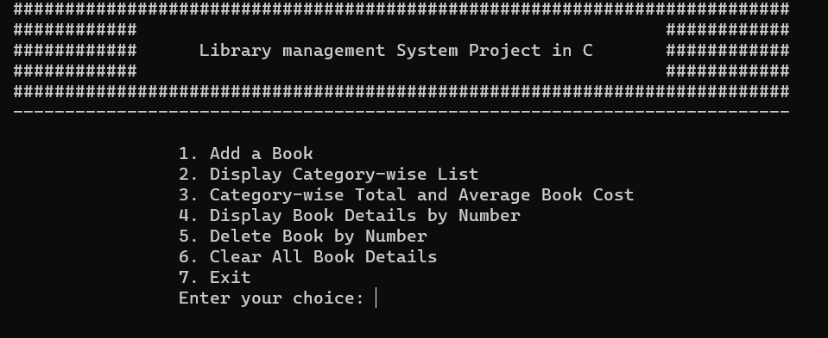
MAIN MENU

Slide 24
DEMONSTRATION
int main(). --- Rushi
void saveBookDetails(); --- Akhila
void saveBookDetailsToFile(); --- Akhila
void displayCategoryWiseList(); --- Shashi
void displayCategoryWiseTotalAndAverage();--- Shashi
void displayBookDetails(); --- Ishanth
int loadBookDetailsFromFile(); --- Ishanth
void deleteBook(); --- Babitha
void clearAllBooks() --- Babitha

Slide 25
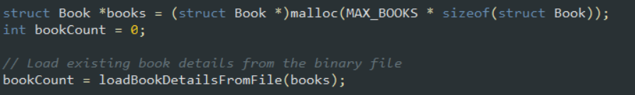
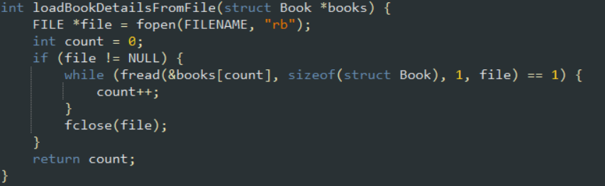
CODE

Slide 26
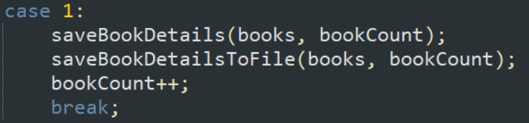
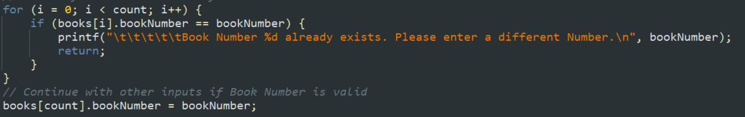
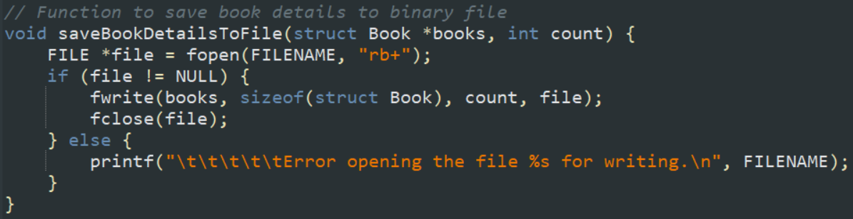
CODE

Slide 27

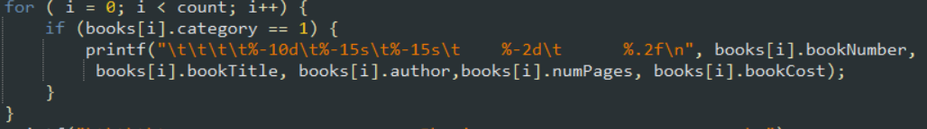
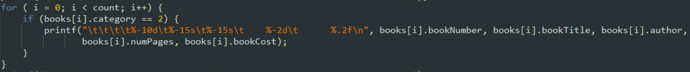
CODE

Slide 28

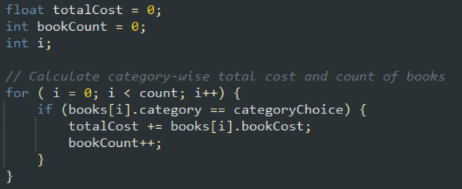
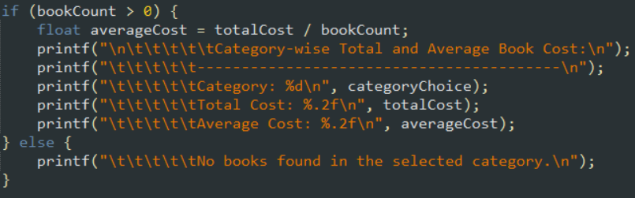
CODE

Slide 29

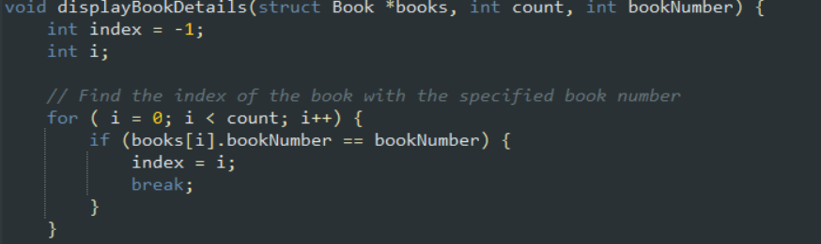
CODE

Slide 30

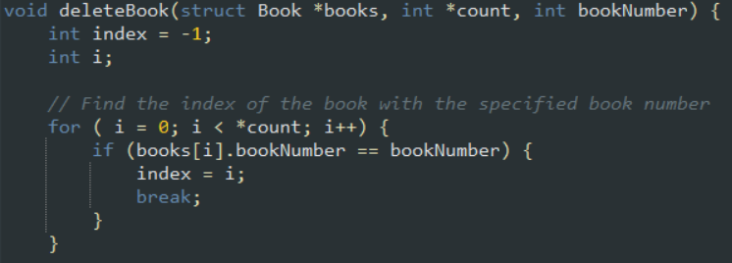
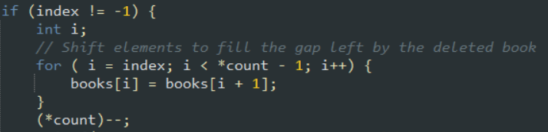
CODE

Slide 31



CODE

Slide 32
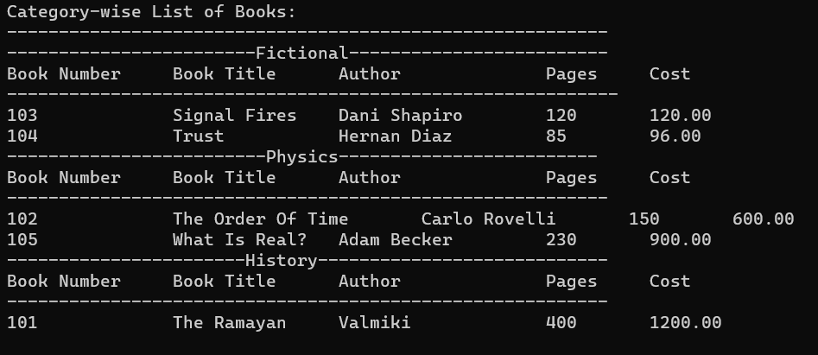
INPUT AND OUTPUT
displayCategoryWiseList(books, bookCount)

Slide 33
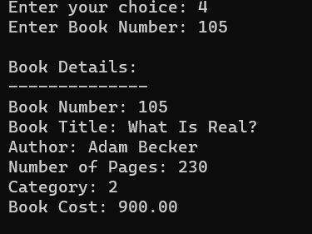
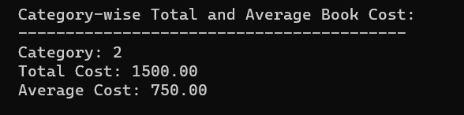
INPUT AND OUTPUT
displayBookDetails(books, bookCount, bookNumber)
displayCategoryWiseTotalAndAverage(books, bookCount);

Slide 34
TOPICS COVERED
Arrays
Structures
Pointers
Loops
Binary Files
User Defined Functions
Menu Driven Interface
Macros
Dynamic Memory Allocation

Slide 35


Slide 36
THANK YOU

